Slide 1

DATA – ARTIFICIAL INTELLGENCE
SQL Server Database Labs
Trainer: Abhishek Sarkar

Slide 2
DATA MODELING IN ACTION
DATABASE ESSENTIALS
HEARTiHEALTH
(Case Study)
Notes:
YOU SHOULD HVE THE DB DEISGN SHARED. THEY SHOULD SEE THE TABLES AND ALSO THE DESIGIN THAT IS GIVEN. MAP THE DESIGN TO TABLES. ENTITIES, ATTRIBUTES, RELATIONSHIPS, KEYS

Slide 3

Case Study
DATABASE ESSENTIALS
India has a population of 1.3 Billion
The Disease Burden
India is witnessing nearly 2 Million Heart Attacks a Year
The frequency of heart disease in young Indians is 15-18% higher than in any other population group globally.
An average Indian spends 2Lakhs on a Heart Surgery to mitigate Risk of Heart Attack
Heart Failure in Numbers
The number of people diagnosed worldwide is expected to increase to 8 million by 2030
23% of Heart Failure Patients die within 1 Year of Diagnosis.
Every year Heart Failure costs the world economy $108 billion
Notes:
Statistics of Size of the Population, People affected by Heart Attack
India has high heart diseases
Research how u do, wat parameters to consider
How to tackle? (Interactive)
Size, Impact – People and Revenues, Longevity
Establish here the impact the solution will provide in terms of People and Revenues

Slide 4

Case Study
DATABASE ESSENTIALS
How can we help to Identify Prior Heart Attacks?
Notes:
Add Problems to solve

Slide 5
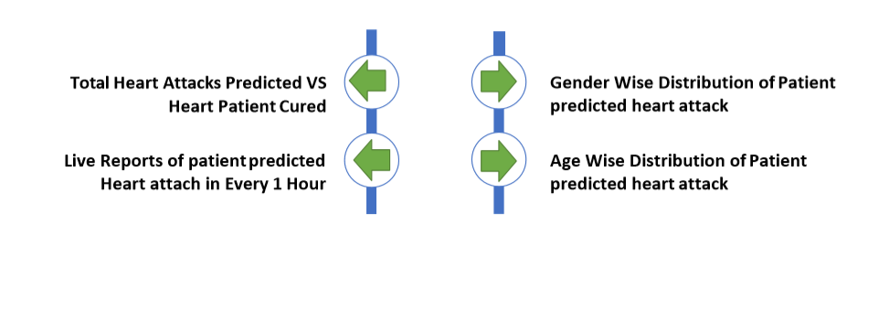
Case Study
Reports and Dashboard
DATABASE ESSENTIALS
Notes:
Add Problems to solve

Slide 6
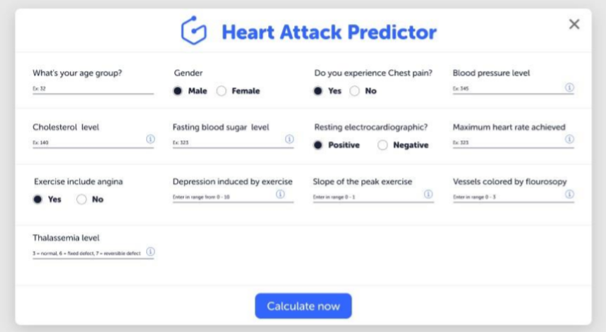
Case Study
Wireframes
DATABASE ESSENTIALS
Notes:
Add Problems to solve

Slide 7
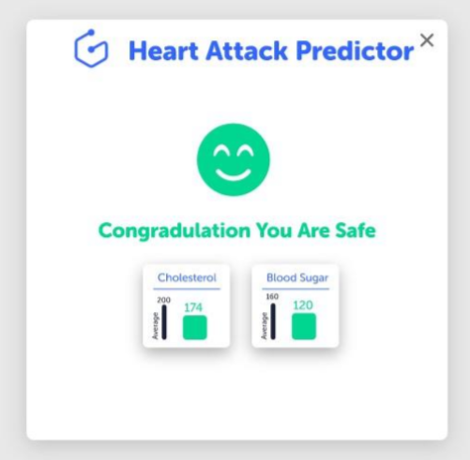
Case Study
Wireframes
DATABASE ESSENTIALS
Notes:
Add Problems to solve

Slide 8
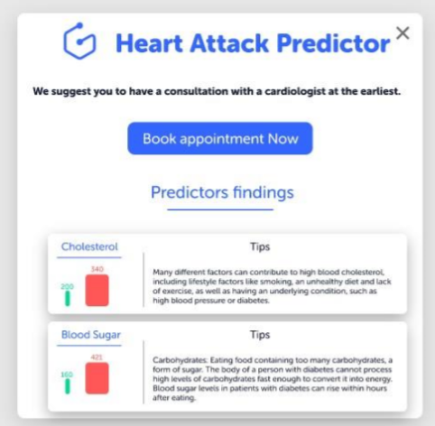
Case Study
Wireframes
DATABASE ESSENTIALS
Notes:
Add Problems to solve

Slide 9
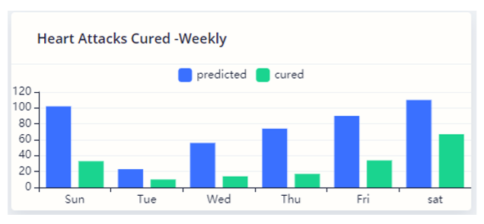
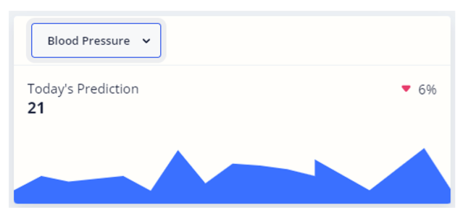
Case Study
Wireframes
DATABASE ESSENTIALS
Notes:
Add Problems to solve

Slide 10
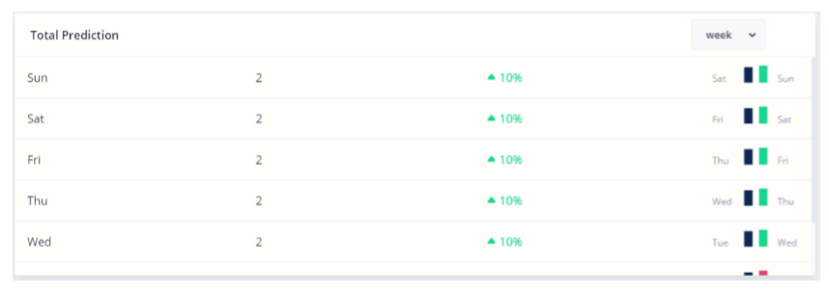
Case Study
Wireframes
DATABASE ESSENTIALS
Notes:
Add Problems to solve

Slide 11
DATA MODELING IN ACTION
DATABASE ESSENTIALS
DATA MODELING
FOR
HEARTiHEALTH
Notes:
YOU SHOULD HVE THE DB DEISGN SHARED. THEY SHOULD SEE THE TABLES AND ALSO THE DESIGIN THAT IS GIVEN. MAP THE DESIGN TO TABLES. ENTITIES, ATTRIBUTES, RELATIONSHIPS, KEYS

Slide 12
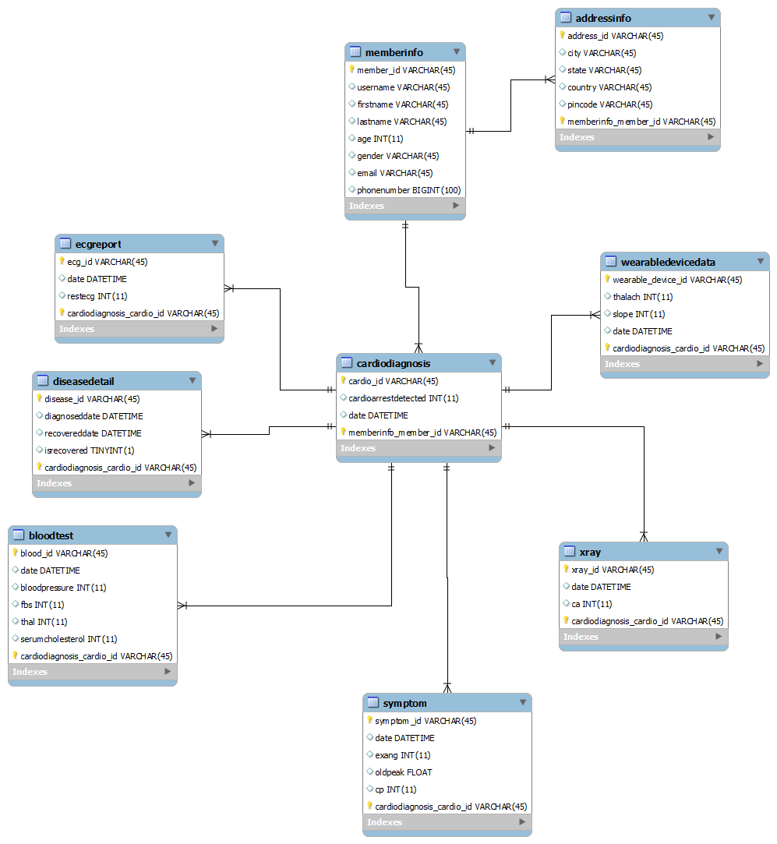
DATA MODELING IN ACTION
Database Diagram
DATABASE ESSENTIALS

Slide 13
Analyze the database diagram provided and understand the different entities, attributes used and the relationships among the entitites.
SQL IN ACTION
DATABASE ESSENTIALS
Lab - 1

Slide 14
SQL IN ACTION
DATABASE ESSENTIALS
Lab-2
The HeartiHealth application is being used by a lot of members, and there are a lot of feedback and enhancements which the members are requesting the team to incorporate it for the next version of the product. As a part of the HeartiHealth Database team, you need to understand the schema of the database, setup the database and also look into some basic queries.
Task:
Create the database schema for HeartiHealth in Oracle DB.
Run the script and INSERT data into the entities.
Execute SELECT statement to check the data

Slide 15
The project owner of HeartiHealth has asked to provide one more feature to the existing application. As patient reviews and opinions matter the most for the services that are provided to them, capturing the reviews from the patients is a new feature that needs to be introduced.
SQL IN ACTION
DATABASE ESSENTIALS
Lab - 3
Task:
Add a new entity “Review” to the existing design. The entity must contain the attributes – ReviewType and Reviews, where reviews can be specific to the condition, medication, reports, visits, etc.

Slide 16
As per the requirement received by the project owner of HeartiHealth, the team has introduced a new section in the application called Statistics. This section need an analytical report of the heart attack predictions that are captured till date. The report will contain the total heart attack predictions for each day.
SQL IN ACTION
Lab - 4
DATABASE ESSENTIALS
Task:
Write a query to get all the predictions for the day, and sort it with the highest percentage of the probability at the top.

Slide 17
In order to conduct some survey, the project owner of HeartiHealth application has asked to get the information of some of the members who are registered with the application, based on the City where they are residing.
SQL IN ACTION
Lab - 5
DATABASE ESSENTIALS
Task:
You need to write a query to get all the members who are from the “Burgos” city.

Slide 18
In the dashboard section of the application, the members/patients of HeartiHealth have requested to display the number of blood tests done for them.
SQL IN ACTION
Lab - 6
DATABASE ESSENTIALS
Task:
Write a query to get the total number of blood tests done for the member “Aisha”.

Slide 19
In the Labs section, all the lab reports for the tests which were conducted for the patients were uploaded into our system and are being stored in the database. These lab reports are stored date-wise. We have received a requirement, that the members now want to view the reports for a particular date.
SQL IN ACTION
Lab - 7
DATABASE ESSENTIALS
Task:
Write a query to get the xray details of “Ajay” whose cardio was done on “26th of Jan 2019”

Slide 20
SQL IN ACTION
DATABASE ESSENTIALS
PL/SQL
FOR
HEARTiHEALTH
Notes:
Actors:
Patient
Insurance companies
Hospitals
Doctors
Application

Slide 21
PL/SQL-Procedures
DATABASE ESSENTIALS
Procedures

Slide 22
We need to get the details of members based on their member ID, so store it as a stored procedure so that it can be used repeatedly.
PL/SQL-Procedures
Lab - 8
DATABASE ESSENTIALS
Task:
Create a Stored Procedure to get the details (firstname, lastname, age) of the members by just passing the member_id as a parameter.

Slide 23
Every time a new patient registers to the system, the details of the member needs to be captured. We need to get the details of a patient and insert it using a stored procedure.
PL/SQL-Procedures
Lab - 9
DATABASE ESSENTIALS
Task:
Create a Stored Procedure to insert the details of the any new member by just passing the details as parameters.

Slide 24
It is sometimes very difficult to find the reports of the patients. Writing a query everytime is also difficult. The DB admin has suggested to create customized Stored Procedures to get the reports(X-Ray) of the patients by just checking the name of the patient and when was he diagnosed for a cardiac test .
PL/SQL-Procedures
Lab - 10
DATABASE ESSENTIALS
Task:
Create a Stored Procedure to get the X-ray report of the patient, based on their name and the date of cardiac test done.

Slide 25
PL/SQL - Functions
DATABASE ESSENTIALS
Functions

Slide 26
The admin of the hospital want to see the total number of patients who are predicted to have a heart attack and also those who are not in the application. Also this would help to create an analytics to measure the efficiency of the HeartiHealth Application.
PL/SQL - Functions
Lab - 11
DATABASE ESSENTIALS
Task:
Create a Function which would provide the count of the patients based on the data stored in the database. Pass the parameter to get count of patients who are predicted or who are safe from getting a heart attack.

Slide 27
PL/SQL - Cursors
DATABASE ESSENTIALS
Cursors

Slide 28
We would like to have a list of records of the patient who are more than 35 years of age. The DB Admin is facing a challenge to get the list using a Stored Procedure. Help him to solve his problem
PL/SQL - Cursors
Lab - 12
DATABASE ESSENTIALS
Task:
Create a Cursor to get the list of patients whose age is greater than 35 years. Call the cursor and print the member_id, username, firstname and age.

Slide 29
PL/SQL - Cursors
Lab - 13
DATABASE ESSENTIALS
Task:
Create a Cursor to print the list of all member within the cursor. Execute the cursor so that it print in this way:
Ex: The member name is : Rahul Sharma
<Note: Do not call the cursor externally>

Slide 30
PL/SQL - Cursors
DATABASE ESSENTIALS
Cursors with Stored Procedures

Slide 31
The admin of the application is facing a challenge to fetch one record at a time for a member. He is looking for a solution to get the list of members based on certain condition, and store the query in a stored procedure, so that depending on the parameter he can anytime fetch the details of the members.
PL/SQL - Cursors
Lab - 14
DATABASE ESSENTIALS
Task:
Write a procedure which will display the list of all members from a given city.

Slide 32
In the HeartiHeath application, the hospital supervisor wants to get the list of patients for a particular age, as he wants to communicate to the patients and convey certain precaution measures to some category of patients. You need to help the DB team to ensure this functionality works.
PL/SQL - Cursors
Lab - 15
DATABASE ESSENTIALS
Task:
Write a procedure which will display the list of all members by passing a particular age.
Print the member_id, firstname, lastname, age, phone.

Slide 33
PL/SQL - Cursors
DATABASE ESSENTIALS
Triggers

Slide 34
The admin of HeartiHealth has noticed that many members are providing someone else’s email ID which is not supposed to be. May be the UI validation was not implemented yet. We need to validate the email IDs from the database level and show an error if that email address already exist in the database.
PL/SQL - Triggers
Lab - 17
DATABASE ESSENTIALS
Task:
Create a trigger, before a new member data is inserted into the database and validate if the email ID provided by the member already exist in the database or not.
Also, if the email does not exist in the database, we should allow to insert the data for the member.

Slide 35
It has been noticed that many members were removed, or some data were tampered, and there was no track of when it was done. There is a request from the admin team to log the changes for the member table so that we can know when a member is added or updated or removed from the system.
PL/SQL - Triggers
Lab - 19
DATABASE ESSENTIALS
Task:
Write a DDL Query Statement to create a new table memberLog, which will keep a log of any changes for the member’s data.
Attributes: change_date date,
mem_id varchar2(45),
operation varchar2(10),
description varchar2(50)

Slide 36

It has been noticed that many members were removed, or some data were tampered, and there was no track of when it was done. There is a request from the admin team to log the changes for the member table so that we can know when a member is added or updated or removed from the system.
PL/SQL - Triggers
Lab - 20
DATABASE ESSENTIALS
Task:
Create a trigger (memberLogTrigger ), which would log the data into the memberLog table whenever any new member is added in the database or if any member’s data is updated.
Sample:

Slide 37
PL/SQL - Triggers
DATABASE ESSENTIALS
Additional Info:
Advantages
Triggers handle errors from the database layer.
Triggers give an alternative way to run scheduled tasks. By using triggers, you don’t have to wait for the scheduled events to run because the triggers are invoked automatically before or after a change is made to the data in a table.
Triggers can be useful for auditing the data changes in tables.

Slide 38
PL/SQL - Triggers
Disadvantages
DATABASE ESSENTIALS
Triggers can be difficult to troubleshoot because they execute automatically in the database, which may not invisible to the client applications.
Triggers may increase the overhead of the SQL Server.

Slide 39

UI Programming
Web Technologies & User Experience Design
THANK YOU

